Slide 1
UI Part 1
Daniel Janák

Slide 2
Content of this lecture
Core content
UMG, CommonUI & Designer
Focus
ActivatableWidgets
Layers
UI Management Input Routing in CommonUI
Additional Resources
Next time
Advanced Lists Data Driven UI UI Materials

Slide 3
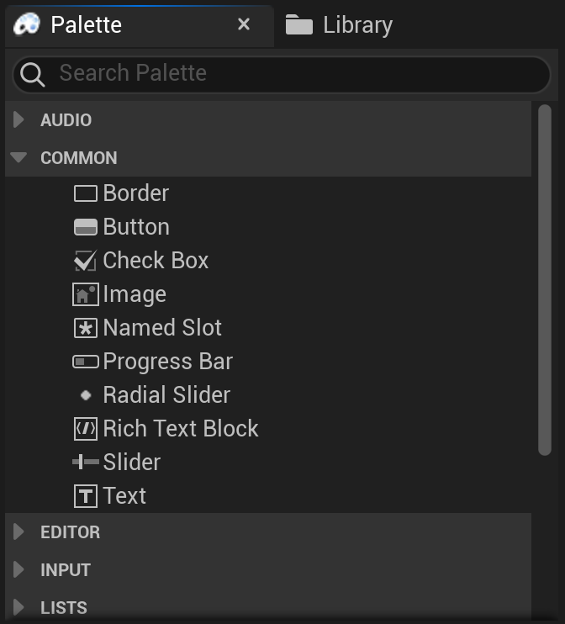
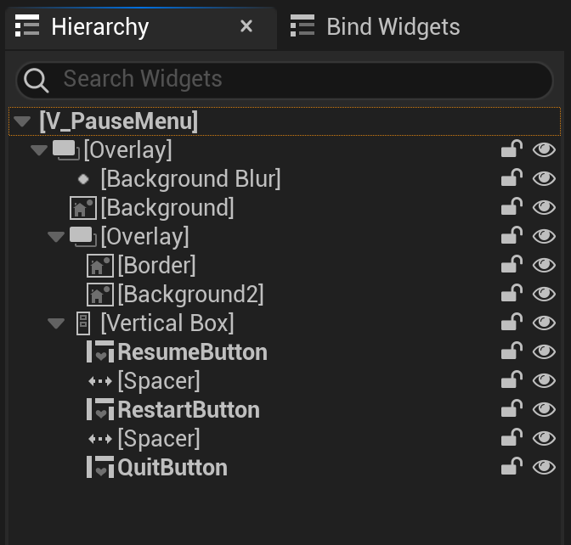
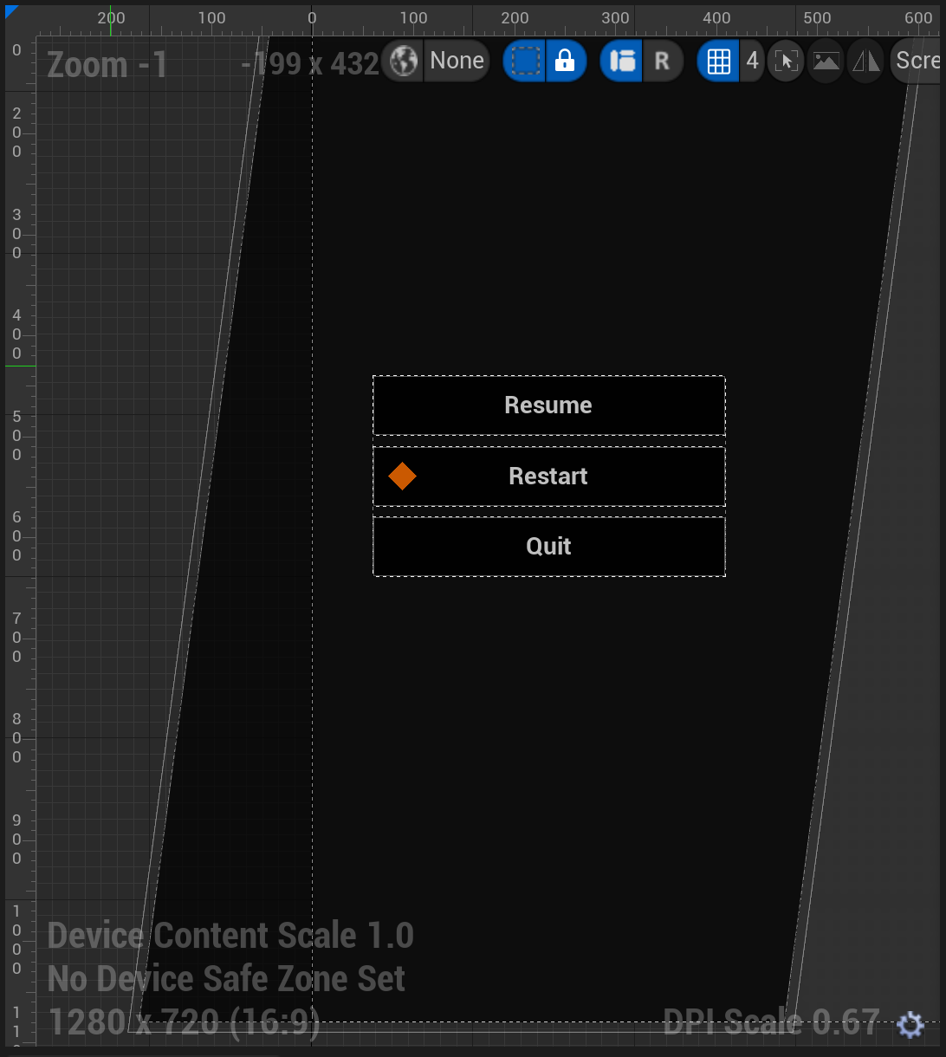
UMG & Designer
Unreal Motion Graphics
CommonUI Optimization Guidelines

Slide 4
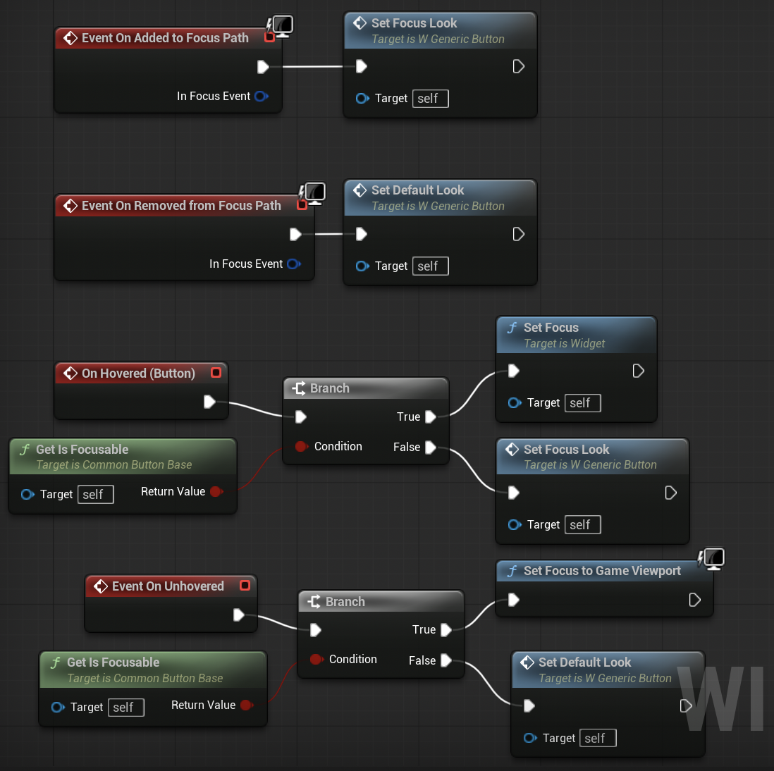
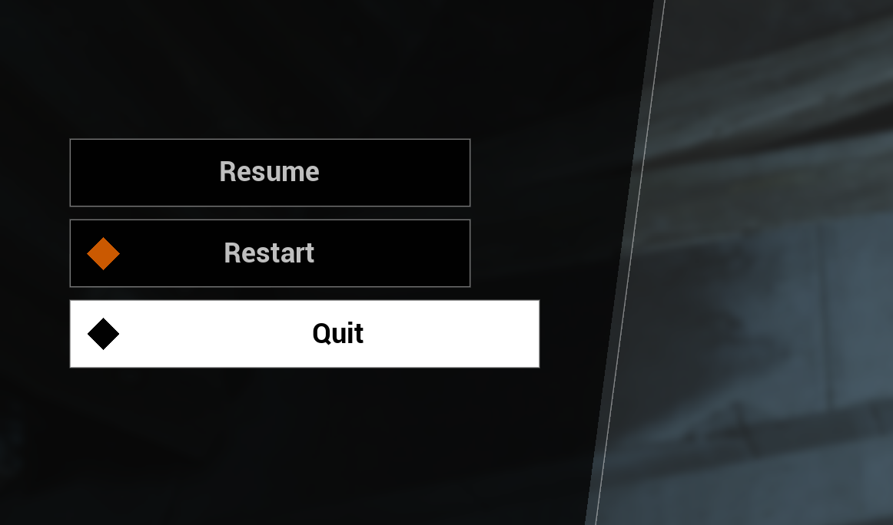
Focus
Core mechanism behind UI navigation
Only one widget at a time
Focus vs Hover

Slide 5
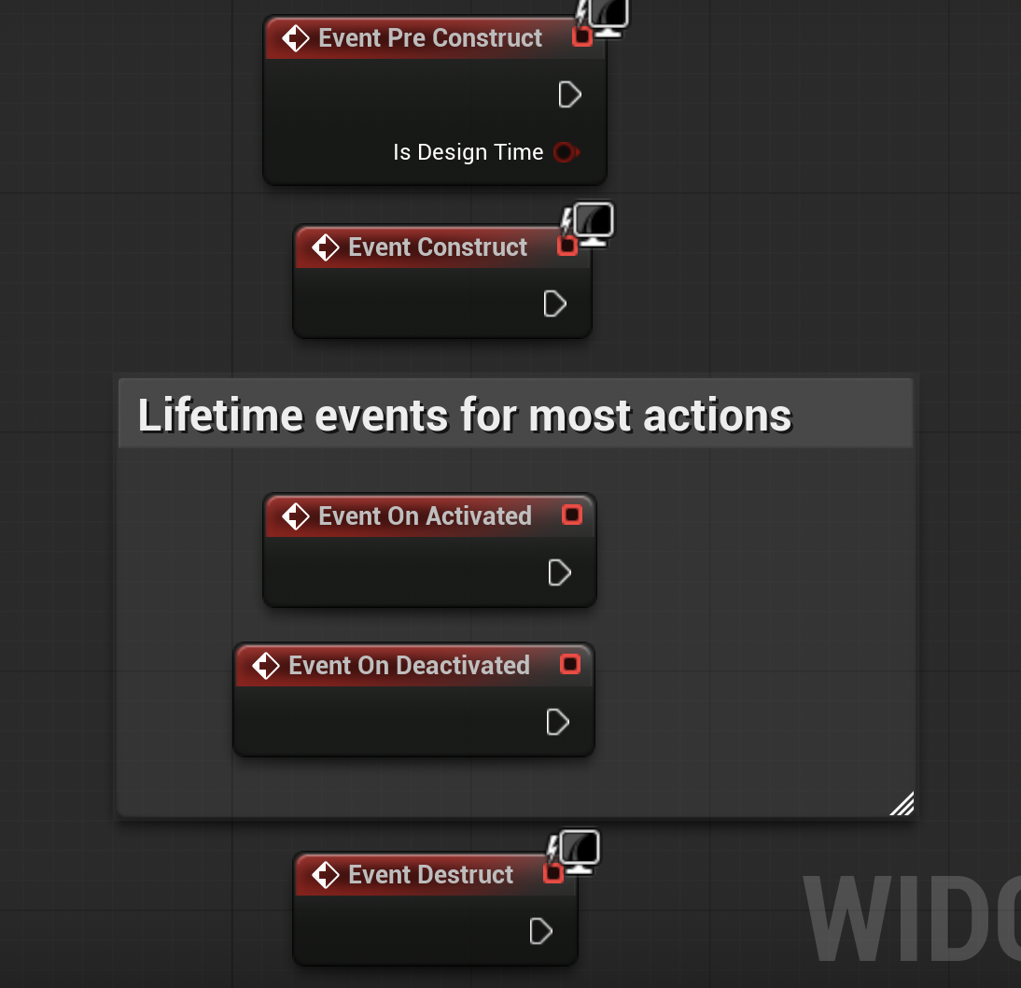
CommonUI – Activatable Widgets
Activatable Widgets - Manages lifetimes - Used by Stack and Queue panels
Input Routing - Tree of Activatable Widgets - Detects top most AW and processes input in the branch Input Modes - Config for Gameplay, Menu, All - Pointer Capture

Slide 6
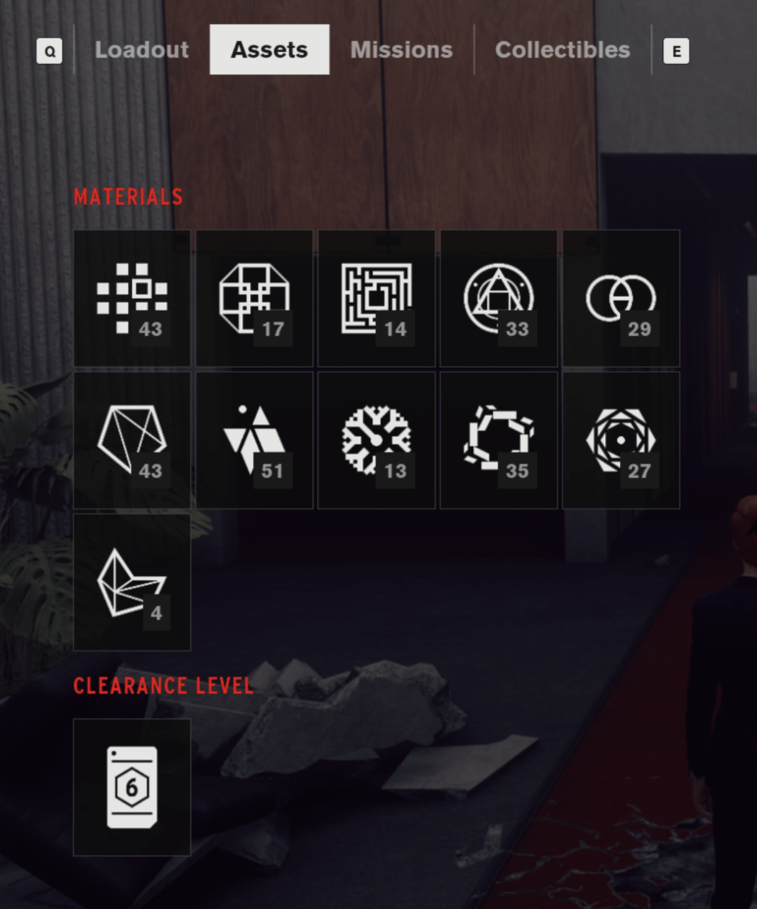
Menus
Partition to standalone Menus and Submenus Event Based, usually no direct access to other Menus Use of Submenus Clean-up on deactivation when switching

Slide 7
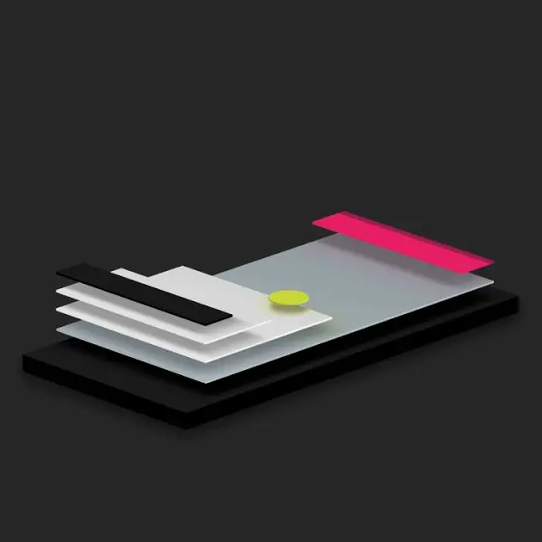
Layers
Grouping of Menus - usually by Stacks and Queues
Use of Layer Widget - Rendering order

Slide 8
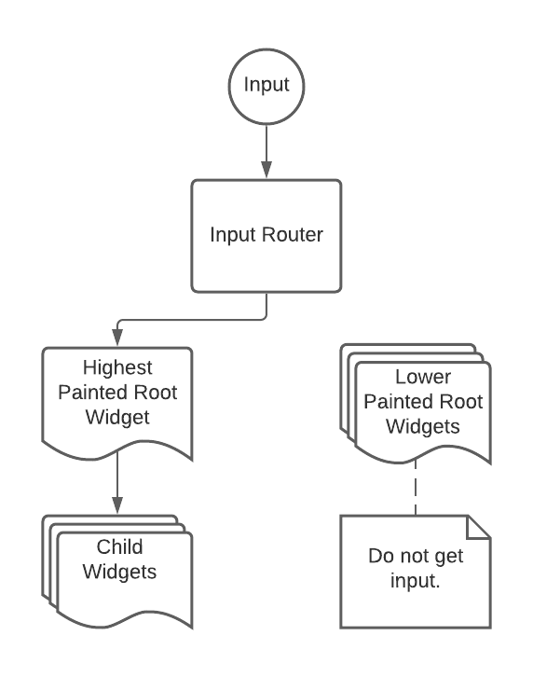
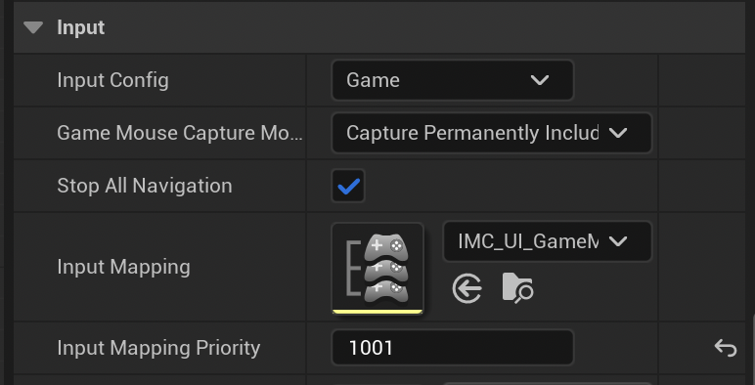
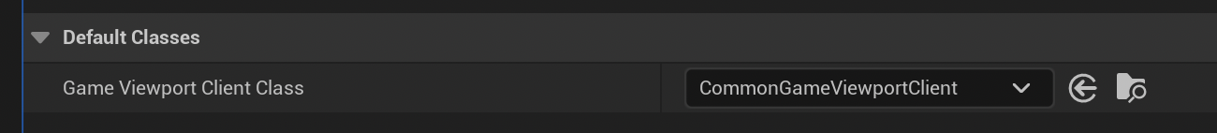
Input Routing
Activatable Widgets contain IMCs
Only highest visible widget (parallel) get input
- Plus all Child Widgets
Default Input Config
- Default Actions for Back and Accept

Slide 9
UI Management
Automates processes
Contains current state of UI
Access to UI from Gameplay Code
Subsystems for additional managers - Notification - Modals
Should be “black box” feature, doesn’t need to bother you when coding Menus themselves
Can be configurable for different levels
Can be implemented either through Subsystem or HUD actor

Slide 10
Let’s create simple menu
Button example explanation
Buttons:
Resume
Restart
Quit
Show menu on Tab press
Hide Quit when gamepad is used

Slide 11
Next Time
Advanced Lists
ListView
TileView
TreeView
UI Materials
Why prefer Materials
Performance Differences

Slide 12
Additional Resources
UI Material Use
Basic Optimizations
CommonUI Overview
CommonUI Tutorial

Slide 13
UI Part 2
Daniel Janák

Slide 14
Content of this lecture
Basic Layouting Rules
Dos And Donts ListViews
Materials Performance

Slide 15
Dos and Donts
Reuse widgets whenever possible Instantiate Widgets on demand Cleanup after yourself Do not access widget properties outside of their scope Avoid getting data in Tick Basic Optimizations

Slide 16
ListView
Scrollable containers that pool widgets and reuse them
ListView
TileView
TreeView
Difference from classic scrollboxes
Data and Widgets are separated
Selectability of Data instead of Widgets
Better autoscroll
Can be combined with buttons

Slide 17
Materials and Performance
Calculations run on GPU
Highly parallelised
Reduce batches
No layout invalidation
Reduce number of widgets used
Unreal Fest 2024

